Slide 1
Reactive Systems Introduction to Reactive Systems and Data Streams
James.Fennell@lit.ie

Slide 2
Reactive Manifesto & Reactive Principles
https://www.reactivemanifesto.org/
Notes:
Organisations working in disparate domains are independently discovering patterns for building software that look the same. These systems are more robust, more resilient, more flexible and better positioned to meet modern demands.
These changes are happening because application requirements have changed dramatically in recent years. Only a few years ago a large application had tens of servers, seconds of response time, hours of offline maintenance and gigabytes of data. Today applications are deployed on everything from mobile devices to cloud-based clusters running thousands of multi-core processors. Users expect millisecond response times and 100% uptime. Data is measured in Petabytes. Today's demands are simply not met by yesterday’s software architectures.
We believe that a coherent approach to systems architecture is needed, and we believe that all necessary aspects are already recognised individually: we want systems that are Responsive, Resilient, Elastic and Message Driven. We call these Reactive Systems.
Systems built as Reactive Systems are more flexible, loosely-coupled and scalable. This makes them easier to develop and amenable to change. They are significantly more tolerant of failure and when failure does occur they meet it with elegance rather than disaster. Reactive Systems are highly responsive, giving users effective interactive feedback.

Slide 3
Responsive
Responsive
Respond in a Timely Manner
Usability
Quick to detect problems
Consistent response times
Requires both scalability and resilience

Slide 4
Resilient
Resilient
Remains responsive despite failure
Containment – contain failures, single component failure does not bring down entire system
Delegation – delegate recovery to external components
Key facets are performance endurance and security

Slide 5
Elastic
Elastic
Can handle volatility in workload
Release resources according to demand
Replication – easily replicate components and distribute inputs
Decentralised Architecture
Reduce potential bottlenecks/Points of Failure
Allow Scaling up or out to deal with increases workload
Scale up/down – provide more/less resources (computing power) to a component
Scale out/in – create/remove multiple identical components

Slide 6
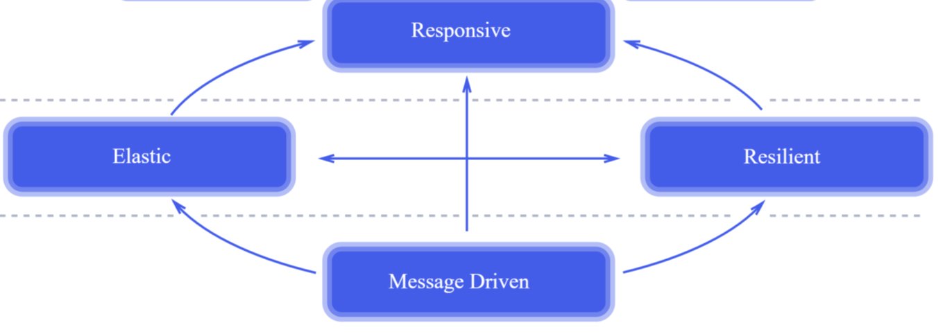
Message Driven
Message Driven Foundation
Asynchronous Message Passing
Establishes a boundary between components
Loose Coupling, Isolation, Location Transparency
Ability to Delegate Errors/Failures as Messages
Non-blocking communication means consumers only use computational resources while active
Enables elasticity and resilience

Slide 7
Benefits of Reactive Systems
More Flexible
Scalable and Resistant
Efficient Use of Resources
Less Latency
More Tolerant of Failure
Highly Responsive

Slide 8
How do we achieve the Benefits of Reactive Systems
Fundamentally Asynchronous and non blocking
Asynchronous
Non-blocking
Use very few threads
Less concern over thread safety
Use concurrent data structures
a particular way of storing and organizing data for access by multiple computing threads (or processes) on a computer

Slide 9
How do we achieve the Benefits of Reactive Systems
We will focus on Asynchronous programs
Clearly defined well bounded components in the system
Each component will communicate using “messages”
Each component will not stop and wait for reply
Communication will be non-blocking
Functional Programming (Lambdas) and Reactive Streams result in less code
Easier to test
Easier to understand
Less errors => better error handling

Slide 10
How do we achieve the Benefits of Reactive Systems
Asynchronous programming refers to parallel programming
Some functionality runs separately from the main application without blocking it
Using multiple CPU cores to execute the tasks, ultimately increasing the app’s performance
Each application has at least one thread, which we usually call the main thread
Other functionalities run in separate threads - notifying the main thread about its progress/failure
Performance and responsiveness of the application improve drastically

Slide 11
What is Reactive Programming
Reactive Programming is a programming paradigm oriented around data flows and the propagation of change
Programming Paradigm => a style of programming
Data Flows => a sequence of ongoing events ordered in time
Propagation of Change => the entire system is aware of any changes

Slide 12
What is a Programming Paradigm?
Programming Paradigm => a style of programming
Imperative languages in which you instruct the computer how to do a task
Imperative languages are like a list of steps for solving a problem, kind of like a recipe
Imperative languages include C, C++, and Java
Declarative languages in which you tell the computer what to do
Declarative languages can further be broken down into functional languages, in which a program is constructed by composing functions, and logic programming languages, in which a program is constructed through a set of logical connections.
functional languages include Scala and Haskell
logic programming languages include Prolog
Note: You can be Object Oriented and Imperative or Declarative
Notes:
https://softwareengineering.stackexchange.com/questions/17976/how-many-types-of-programming-languages-are-there

Slide 13
What is Propagation of Change?
Propagation of Change => the entire system is aware of any changes
Consider the statement a = b + c
Imperative
a is assigned the result of b + c in the instant the expression is evaluated
Later b and c can be changed with no effect on a
Reactive
The value of a is automatically updated if the values of b and/or c change, without the program having to re-execute the statement
Example: Excel Spreadsheet formulae “=B4+D2”

Slide 14
Data Streams
Any data can be represented as a stream
Variables, user input, properties, caches, data structures, and click events
E.g. Tweets with a specific hashtag as a data stream
A stream emits data values over time
A value(s)
An error event
A completion signal (end of stream)

Slide 15
Data Streams
A stream can be used as input to another stream
Multiple streams can be used as input to another stream
You can merge two streams into one
You can filter a stream
you can map data values from one stream to another

Slide 16
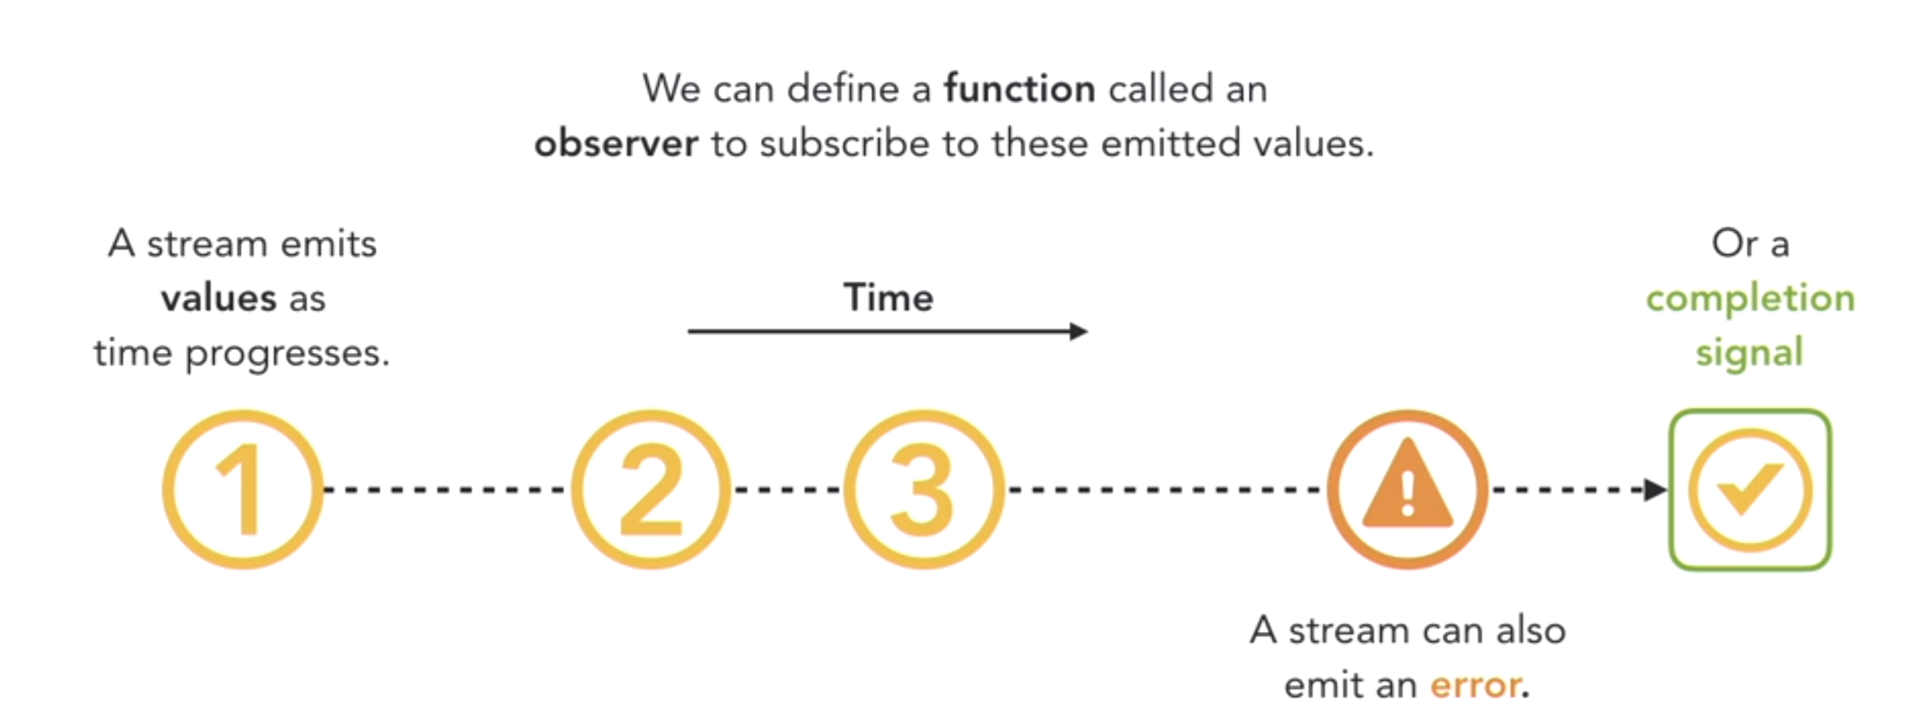
Data Streams

Slide 17
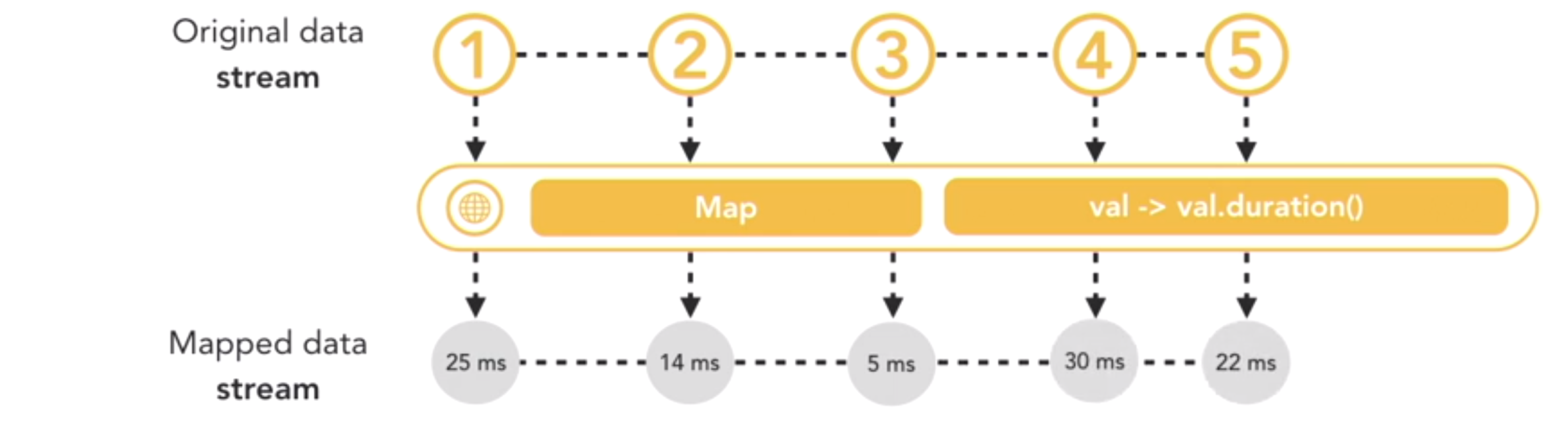
Data Streams - Mapping
A map operation will map each value to the field duration of that value
The end result of this operation will leave us with a stream of duration values

Slide 18
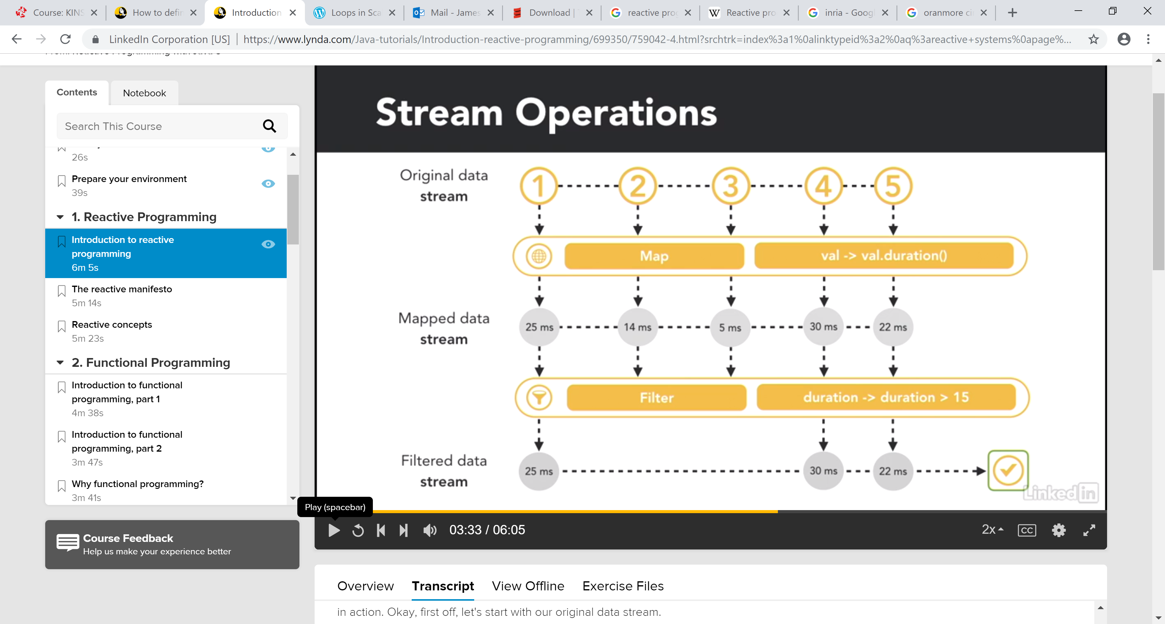
Data Streams - Filtering
A Filter operation will filter out values we don’t want
We want to keep values greater than 15
Here we take our previously mapped stream and Filter it to only keep values greater than 15

Slide 19
How will we code in a Reactive manner?
We will first look at implementing the reactive principles in Java using the RxJava library
http://reactivex.io
Libraries available for multiple languages
We will then look at using a functional language, Scala
Every principle you will learn in this module will have applications in a broad spectrum of languages

Slide 20
Streams in RxJava
Elements involved in Reactive Programming
Backpressure
Principles of Reactive Applications
Reactive Programming in Java

Slide 21
Data Stream
A stream is a sequence of ongoing events ordered in time
A stream can be viewed as a pipe which supports data moving in a set direction

Slide 22
Sources & Message Type
A stream must have at least one source
There are three types of messages sent
A Value
Standard Communication
An Error
Something went wrong
A Completed Signal
The stream is finished
A Value
String/Number/ Data Object
Error
Complete

Slide 23
Reactive Programming
A stream will have at least one consumer
A consumer issues a subscription to a data flow
The subscription ensures the source does not overflow the consumer
They will receive messages that the source(s) emit
Consumers don’t pull data
Data is pushed to the consumer
The consumer doesn’t know when or if data will come
Source
Consumer

Slide 24
Subscriptions Hot & Cold
A cold source of information starts running upon subscription
A hot source of information is always emitting data, whether there is a subscription or not

Slide 25
Subscriptions Hot & Cold
A cold source of information starts running upon subscription
The subscription:
Creates a source of information
Activates the source
Consumer starts listening
Unicast – only the consumer is listening
A hot source of information is always emitting data
The subscription:
Shares a reference
Consumer starts listening
Multicast – multiple consumers can listen

Slide 26


Back Pressure
Problem
A fast source of data should not overwhelm a slow consumer
Solutions
Pull
Protects us from overwhelming the consumer
Waste resources on the consumer when it can handle data flow
Increase the buffer size for the consumer
Not realistic there is finite memory available, eventually run out
Drop elements
Far from ideal

Slide 27

Back Pressure
Problem
A fast source of data should not overwhelm a slow consumer
Solution – Bi-directional Flow of Data
1- elements emitted downstream from source to consumer
2- a signal for demand emitted upstream from consumer to source
If the subscriber is placed in charge of signalling demand, the publisher is free to safely push up to the number of elements demanded.
This also prevents wasting resources
demand is signalled asynchronously
a subscriber can send many requests for more work before actually receiving any
Notes:
https://blog.redelastic.com/a-journey-into-reactive-streams-5ee2a9cd7e29

Slide 28
Reactive Systems in Java
Java is not natively reactive
We can build reactive layers on the JDK
RxJava is an open source project developed by Netflix
It enables the development of reactive systems
Reactor, Spring, Ratpack and Akka are other libraries and frameworks that help build reactive systems in Java

Slide 29
Reactive Programming
Synchronous Data Stream
Steady streams of data at constant volume and rate
Synchronous communication examples include: skype calling, instant messaging, nearly all video/audio communications
Asynchronous Data Stream
Bursts of data at inconsistent intervals
Asynchronous communication examples include: email, texting, newsgroups, blogs, social media

Slide 30
Reactive Programming
The term asynchronous programming means parallel programming where some unit of work or functionality runs separately from the main application without blocking it. It's a model that allows you to take leverage of the multiple cores of the system. Parallel programming uses multiple CPU cores to execute the tasks, ultimately increasing the performance of the application. We know very well that each application has at least one thread, which we usually call the main thread. Other functionalities run in separate threads. We may call them child threads; they keep notifying the main thread about its progress as well as failure.
The major benefit provided by the asynchronous approach is that the performance and responsiveness of the application improve drastically. In today's world, the application market is too demanding. No one wants to be kept waiting while the application is processing things that one needs an answer for. No matter whether it's a desktop application or the web, users prefer to continue enjoying the application while the application is computing a complicated result or performing some expensive task on a resource. We need this in all the scenarios where developers don't want to block the user while using the application.

Slide 31
Reactive Programming
Reactive programming is programming with asynchronous data streams
Event buses or your typical click events are really an asynchronous event stream, on which you can observe and do some side effects.
You are able to create data streams of anything
Streams are cheap and ubiquitous, anything can be a stream:
variables, user inputs, properties, caches, data structures, etc.
For example, imagine your Twitter feed would be a data stream in the same fashion that click events are.
You can listen to that stream and react accordingly

Slide 32
Imperative vs Reactive Programming
With Imperative programming we pull and process requests synchronously using iterators
With Reactive Systems we convert that into a push model
We have a stream of events and we push the elements into an existing data stream
Notes:
https://www.youtube.com/watch?v=dwP1TNXE6fc

Slide 33
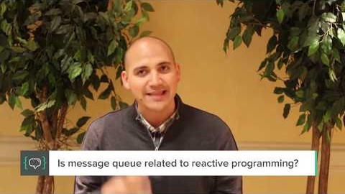
The benefits Reactive Programming
Notes:
https://www.youtube.com/watch?v=dwP1TNXE6fc

Slide 34
The benefits Reactive Programming
Interview with Jafar Husain
Two Object Oriented design patterns consume data
The Iterator
Consistently access all elements in a collection
Consumer asks for an iterator and progressively pull values from collection
3 outputs, value, end of collection, error
The Observer
Producer pushes notifications to subscribes consumers via a callback
No way to tell the consumer “No more events” or “There was an error”
Notes:
https://www.youtube.com/watch?v=dwP1TNXE6fc

Slide 35
The benefits Reactive Programming
Blend Iterator and Observer to make a Observable
Adds two more functions to Observer pattern that pass “no more data” and “error” messages
Now Iterable and Observable can be used in the same way
Iterables allow us to call query functions on static data
The Observable pattern allows us perform queries on data streams

Slide 36
The benefits Reactive Programming
We can now evaluate data in real time without storing it
Massively important in modern technology
Applications must be ready to react to events dynamically
Not just for massive data stores
Events can include things like keystrokes and clicks on a webpage
These events can kick off entirely different processes in the application
We can now handle events like a collection
Map, filter, reduce, zip

Slide 37
The benefits Reactive Programming
Using the twitter API we can filter data so we only deal with data that is relevant to us
Hashtag, key word, images etc.
Netflix middle architecture is essentially one big function
Retrieving data for a grid of videos, queries requests metadata for all movies
Apply a function that extracts records of interest but discarding others
Build Grid from records that are interest
Notes:
https://medium.com/netflix-techblog/reactive-programming-in-the-netflix-api-with-rxjava-7811c3a1496a

Slide 38
The benefits Reactive Programming
No state in the middle architecture which processes the data stream
State at the user end, state at the data end
Events/Messages are data objects
Notes:
https://medium.com/netflix-techblog/reactive-programming-in-the-netflix-api-with-rxjava-7811c3a1496a

Slide 39
Benefits for Netflix from the Reactive Manifesto
No need to aggregate up loads of data and run a query and provide the output
Take data stream and provide results immediately
Less storage
Less management of entire data objects
Quicker processing all along the chain from each machine/server right up to end user
Notes:
https://medium.com/netflix-techblog/reactive-programming-in-the-netflix-api-with-rxjava-7811c3a1496a

Slide 40


